Slide 1
Neighbour In Need
Mobile Computing
15.07.2020 - SS 2020
Fanni Marosi, 764345
Ebru Özcelik, 764349

Slide 2
Agenda
Reminder
Tasks and time schedule
Current status
Implemented requirements
Requirements, we didn‘t implement
Project progress and problems
Testing and evaluation
One-pager
Demo

Slide 3
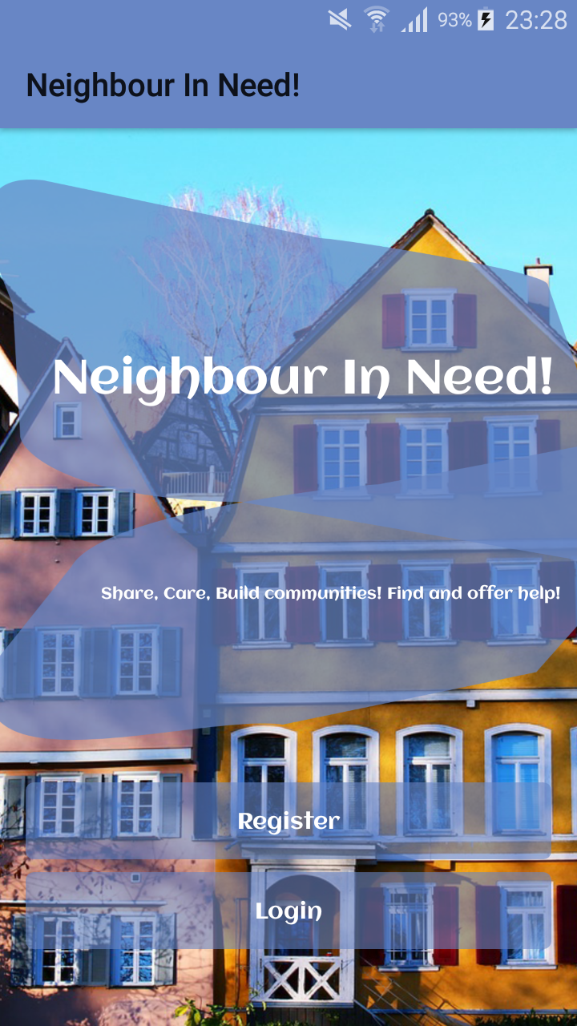
App for the communality
Users can:
Register
Create advertisements
Search for advertisements
Contact advertiser
See own profile
See own advertisements

Slide 4
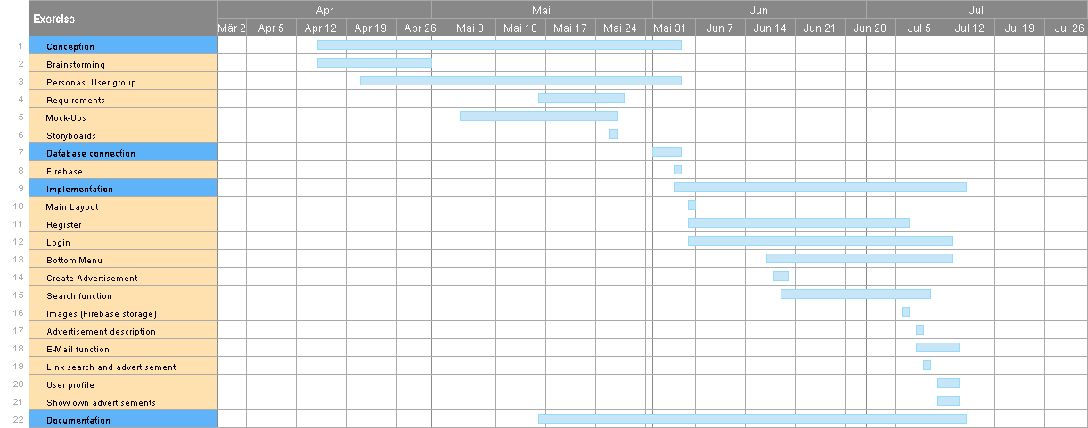

Slide 5
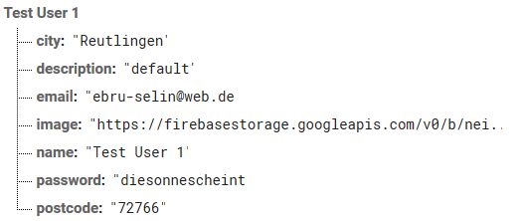
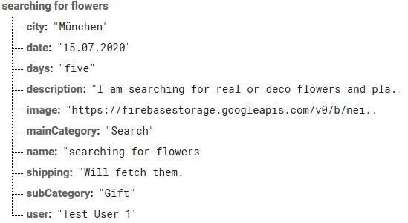
a) Firebase Realtime Database
Cloud-hosted
Multi-user application
Flat data structure
JSON representation:
Users
Advertisements
ConnectionTableRequested

Slide 6
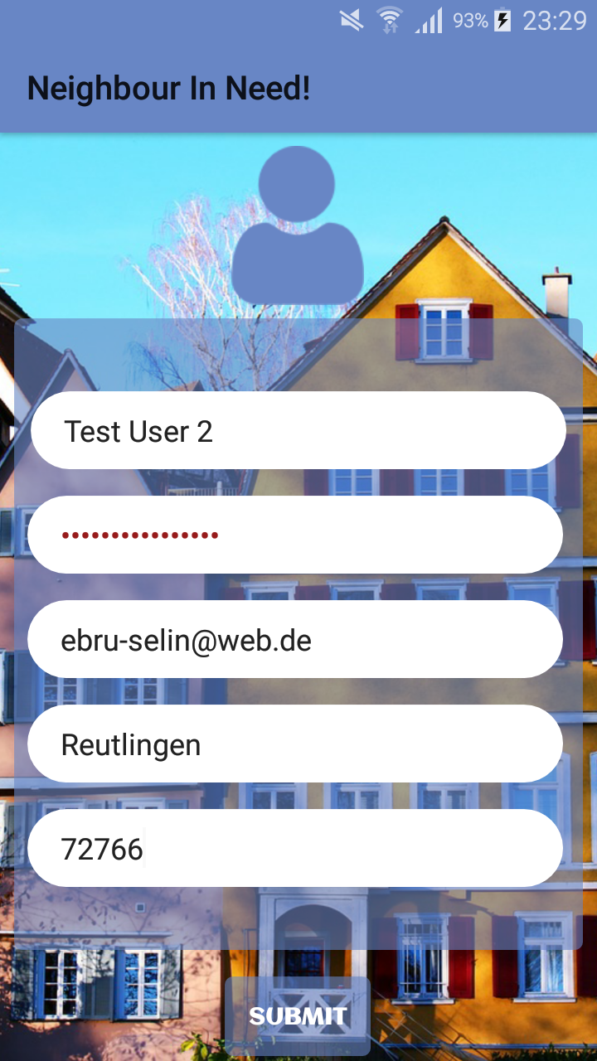
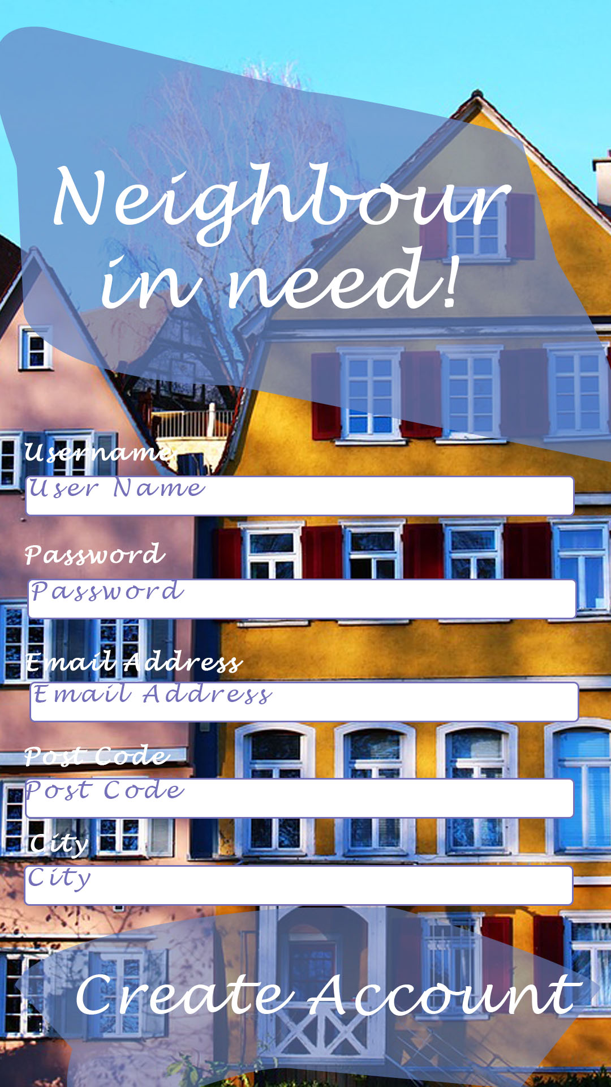
a) Register
Users can create a profile
Data persisted in db
Application
Prototype

Slide 7
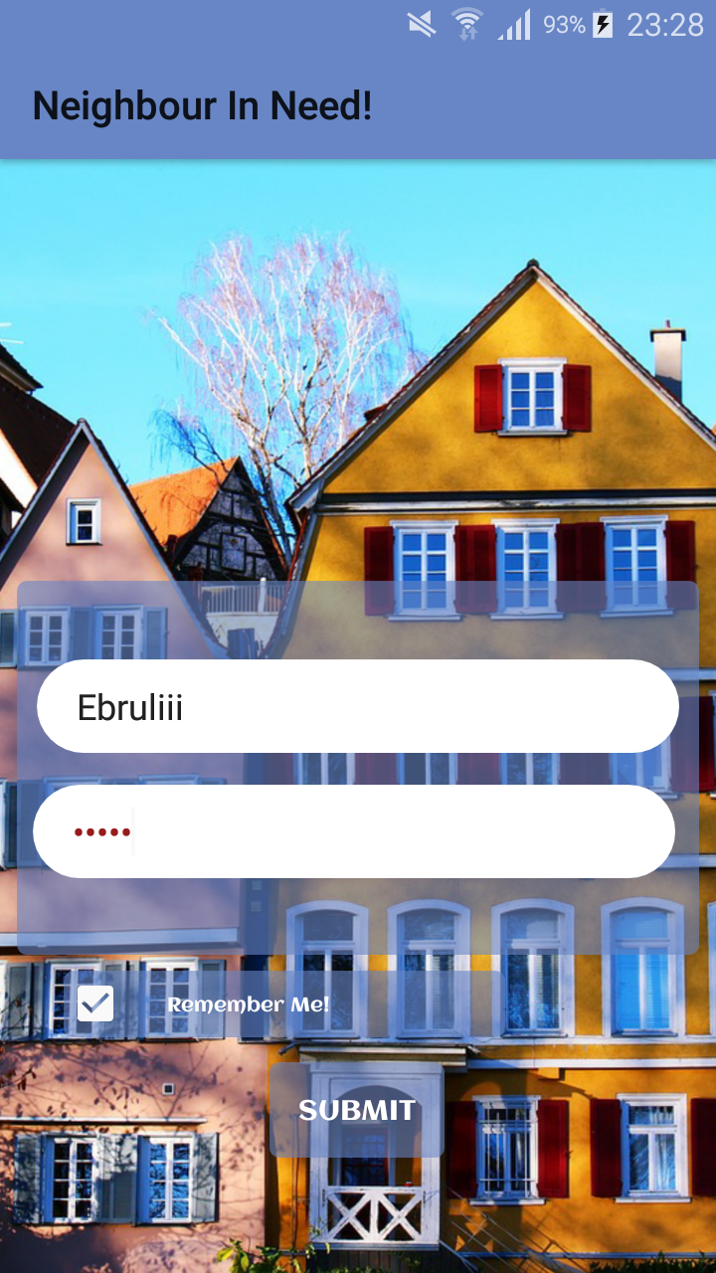
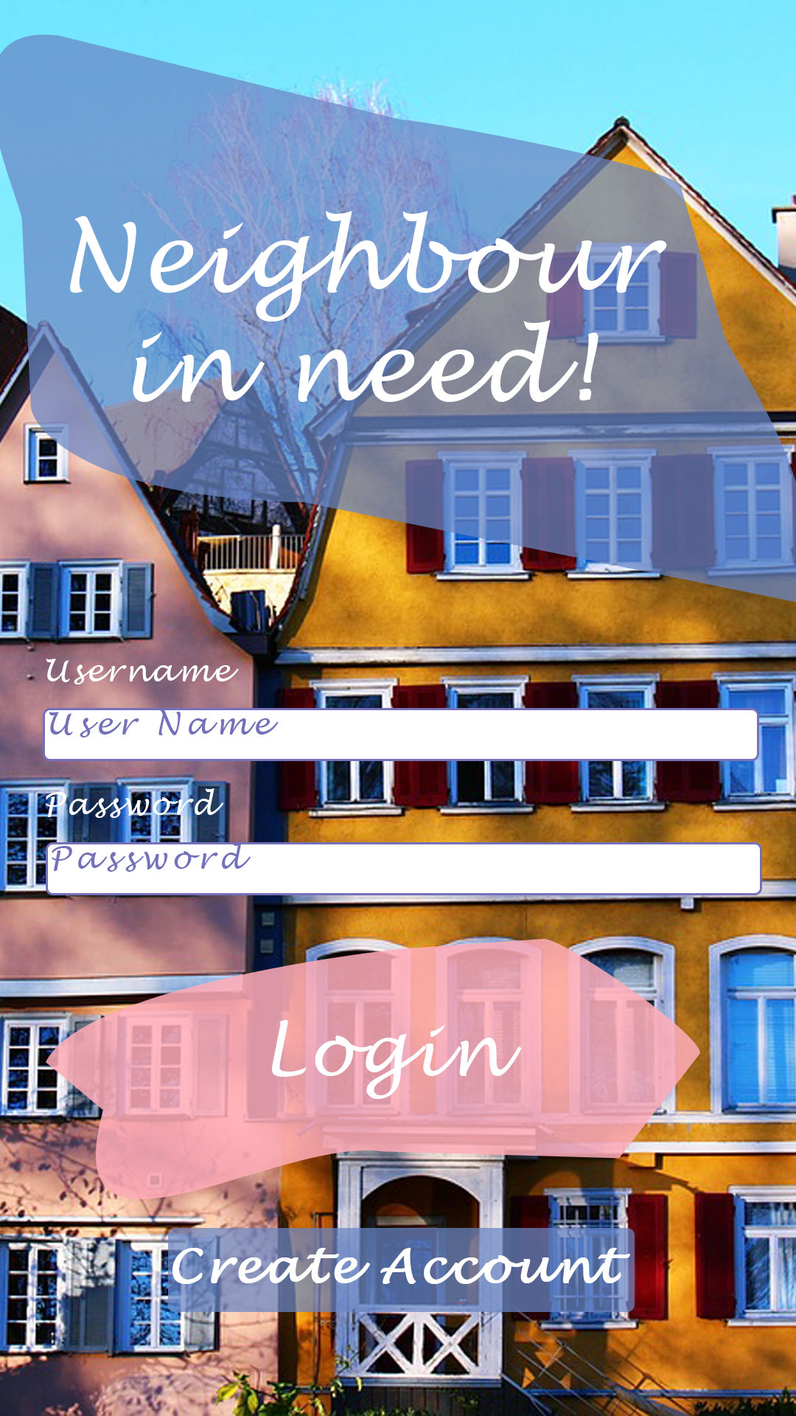
a) Login
Users can login
Remember me
Application
Prototype

Slide 8
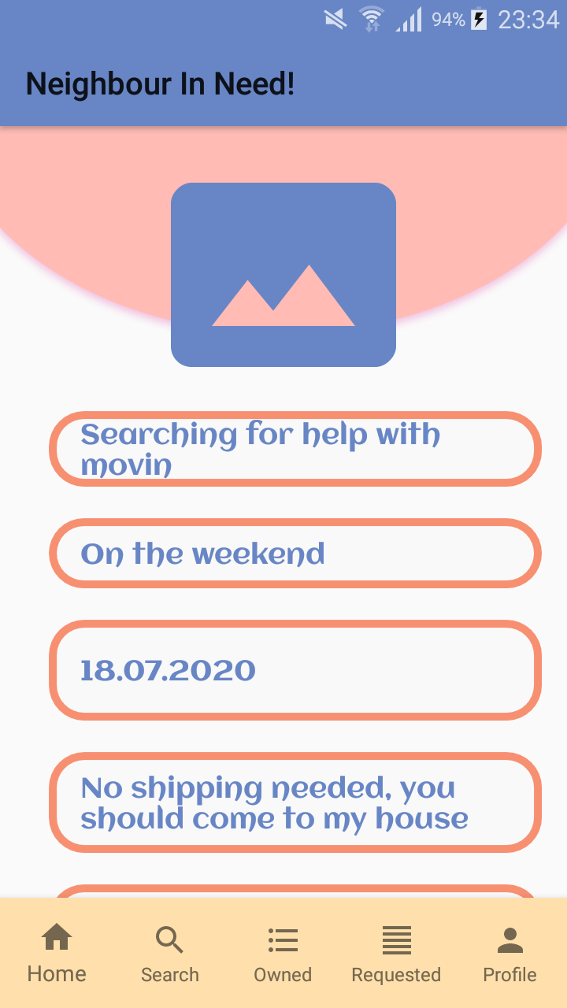
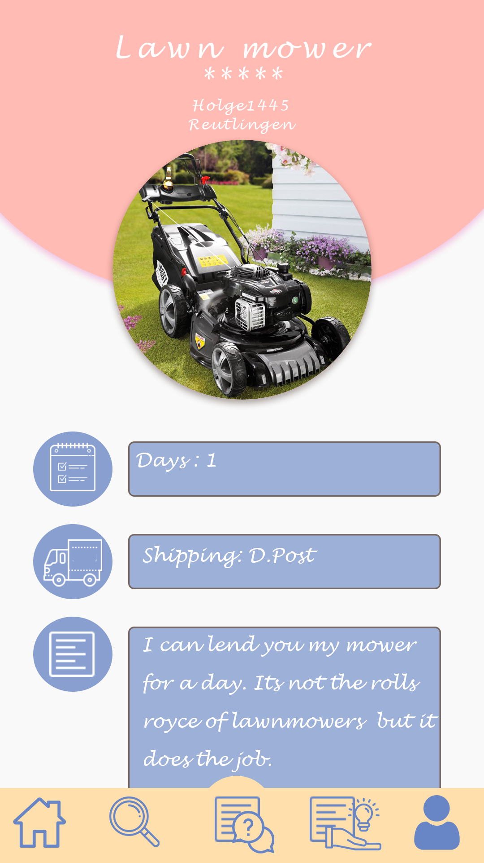
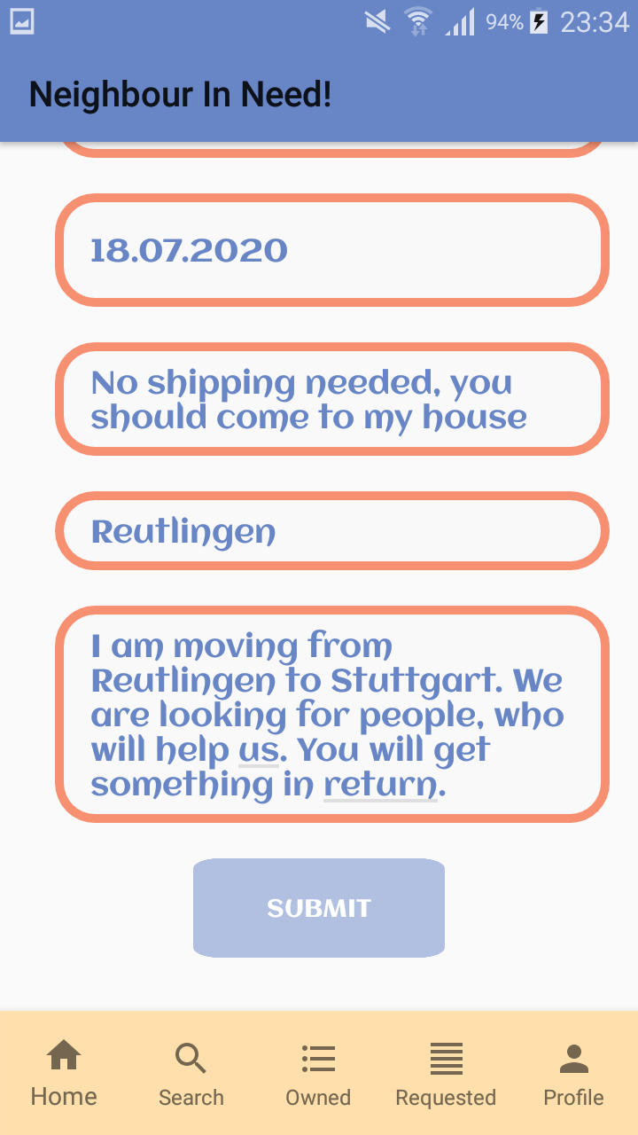
a) Create advertisement
Users can create an advertisement
Application
Prototype

Slide 9
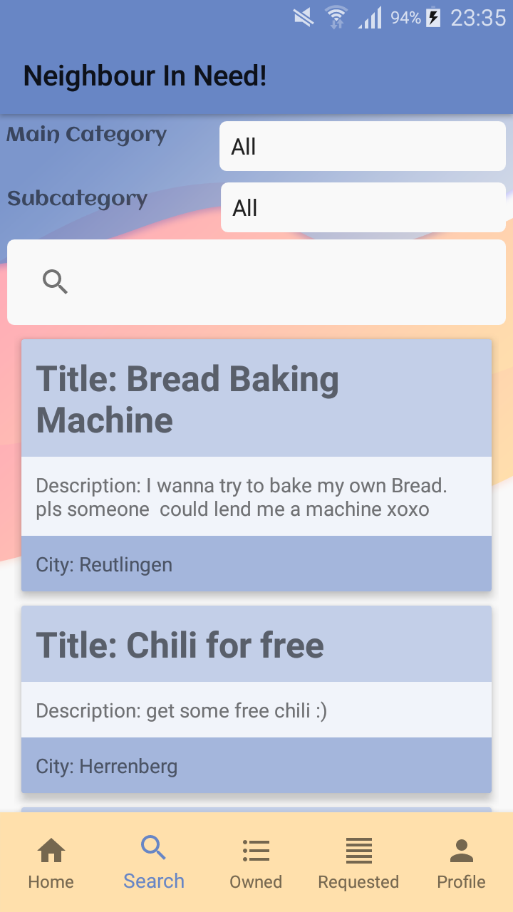
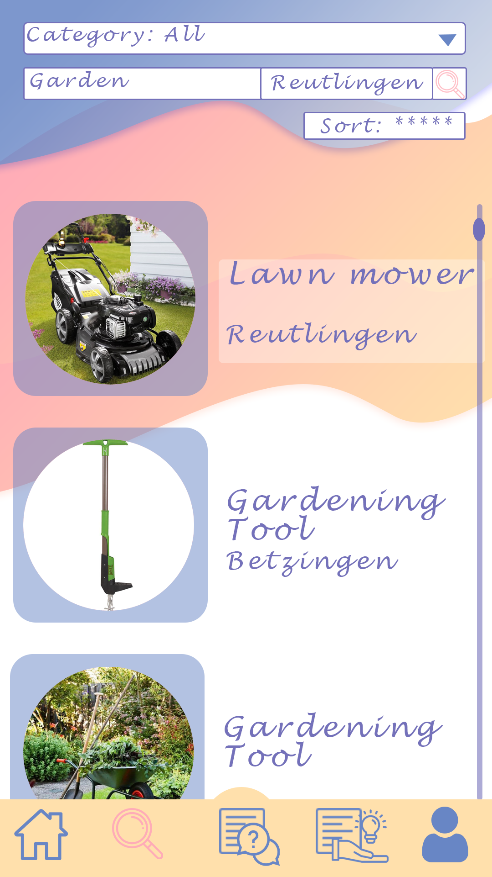
a) Search function
Users can search for advertisements
SearchView
RecyclerView
Adapter Class
OnClickListener
Application
Prototype

Slide 10
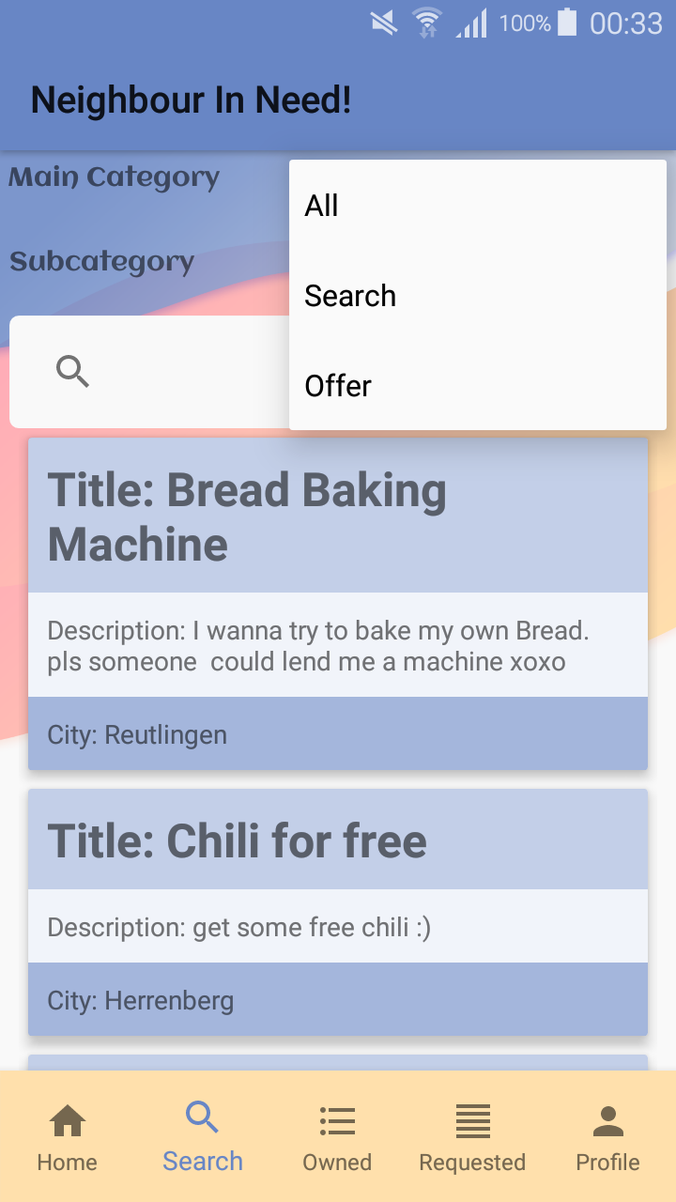
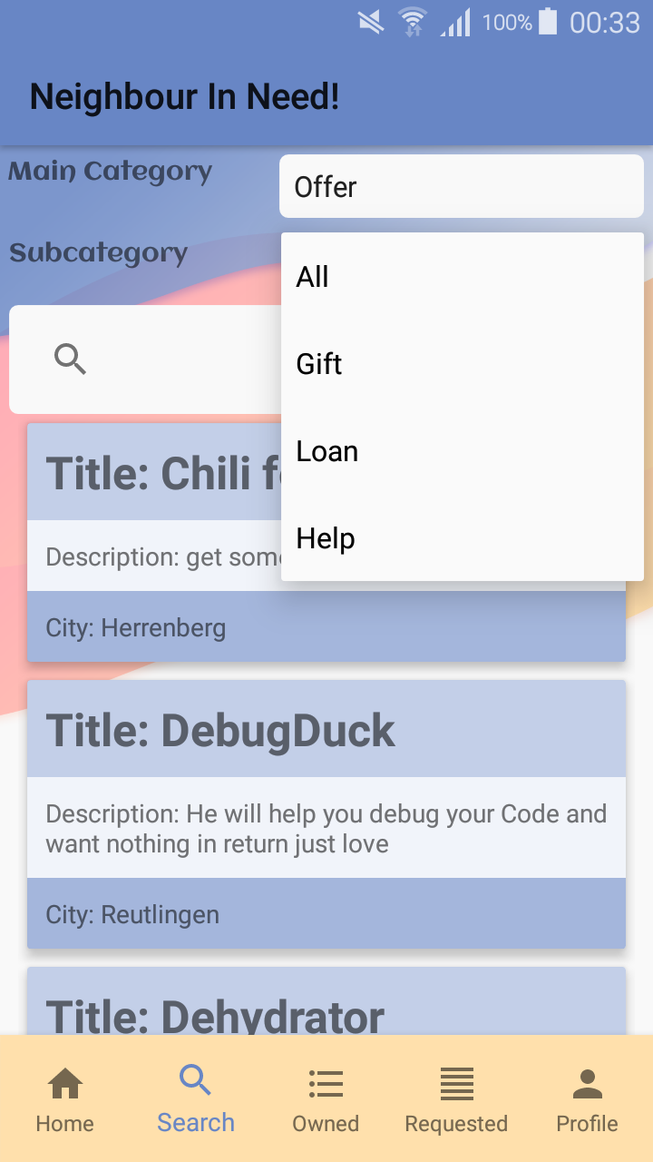
a) Filter function
Filter by main and subcategory
Application

Slide 11
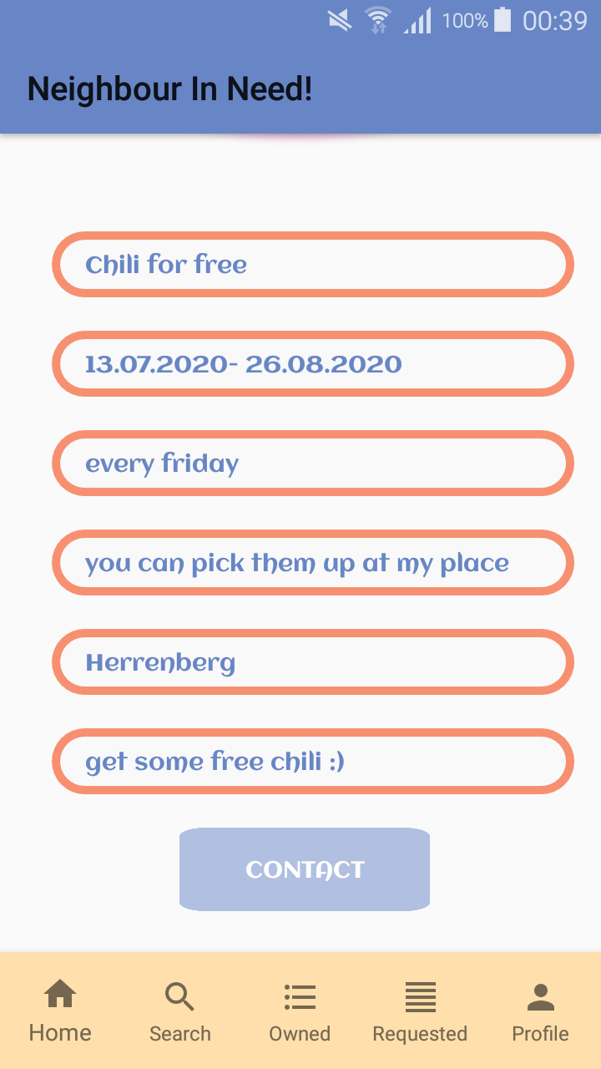
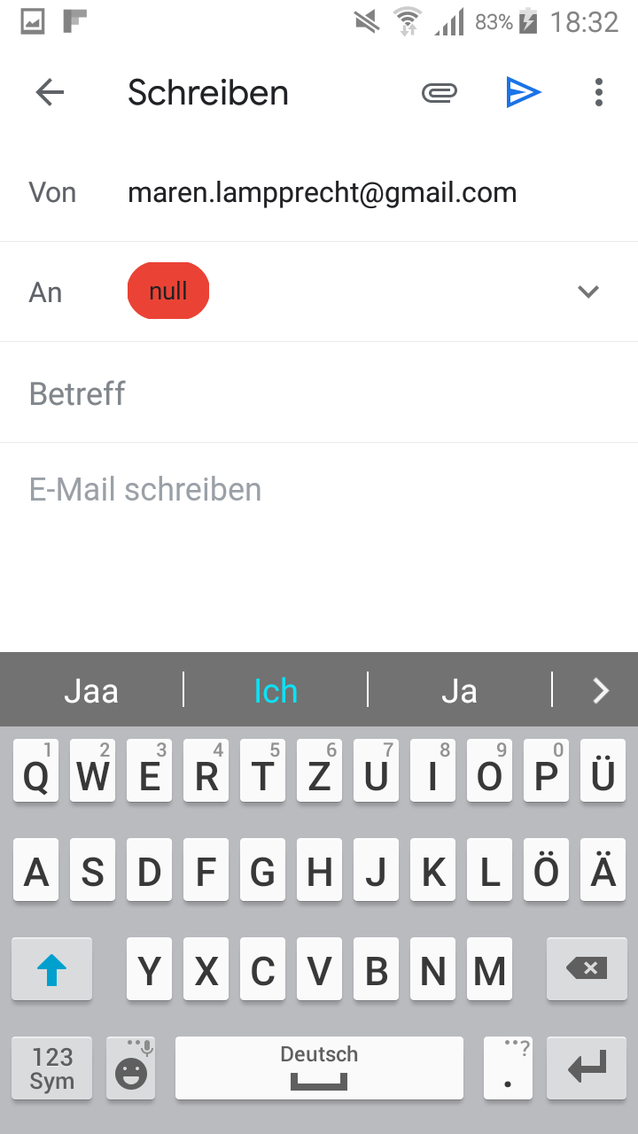
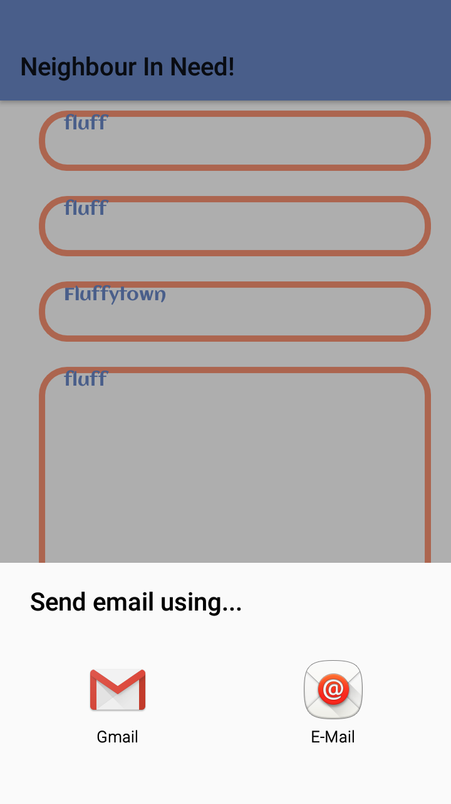
a) Ad description and Email function

Slide 12
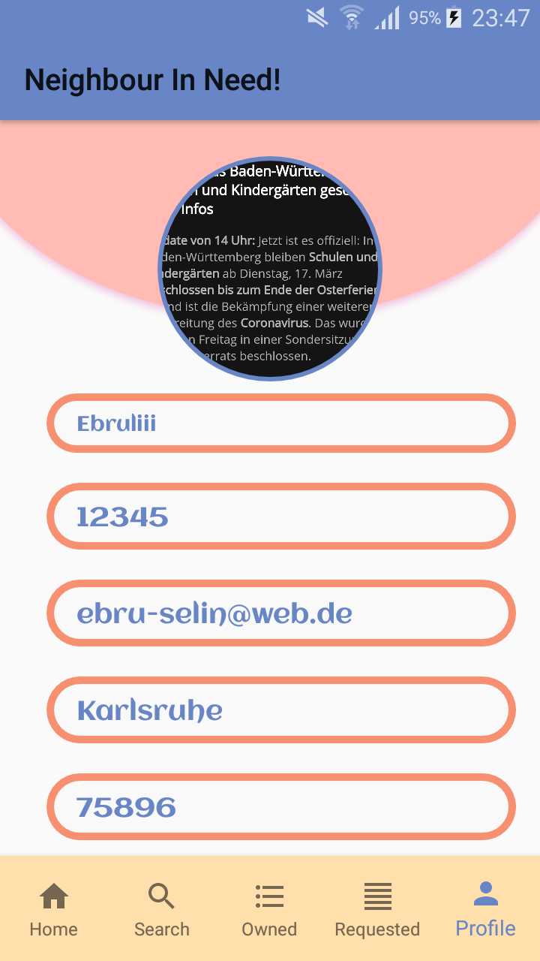
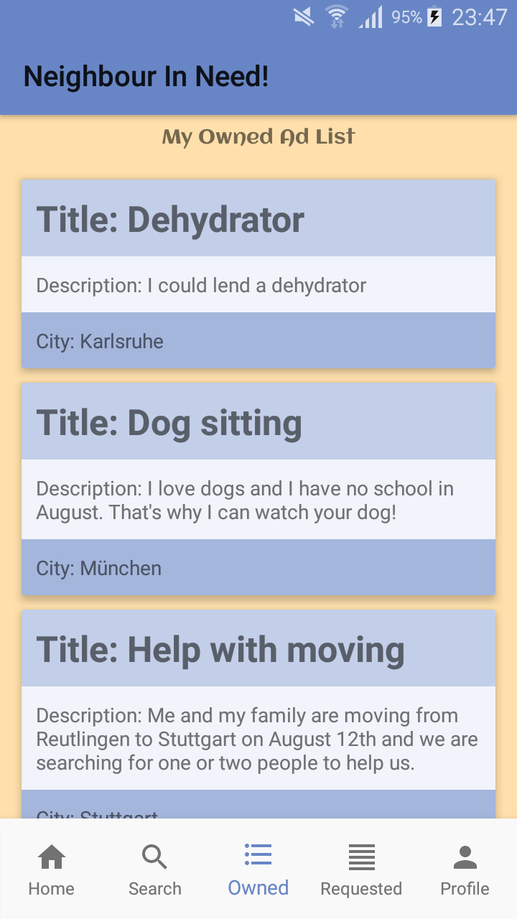
a) User profile and own advertisements
See own profile, no editing possible
See list of created advertisements

Slide 13
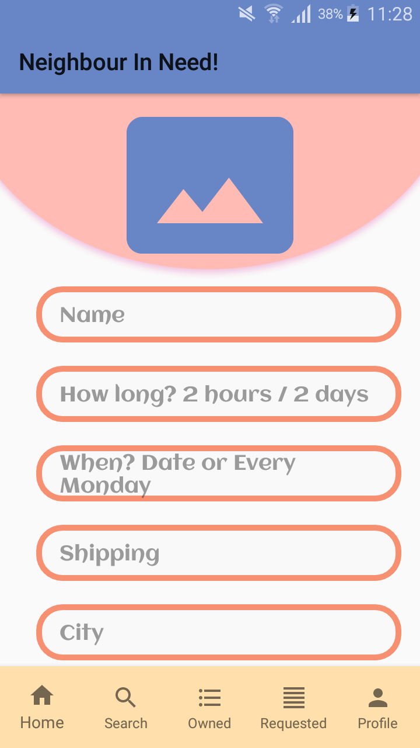
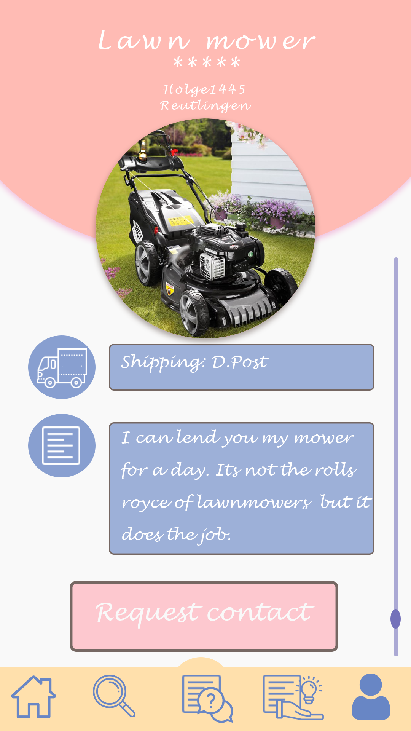
a) Bottom Menu
Navigation in every screen
Application
Prototype

Slide 14
b)
Functional Requirement | Level of importance
Create an account | 5
Login | 5
Create an advertisement | 5
Search for an advertisement | 5
Pick one advertisement from the list of results | 4
Request personal information | 4
Account management/settings | 3
Edit personal information | 3
Advertisement management „Offer“ | 3
Advertisement management „Borrow“ | 3
Rate other users | 2
Sort result list | 1
1 = not that important 2 = nice to have 3 = quite important 4 = important 5 = main or basic functionality
Requirements, we didn‘t implement
Requirements, we implemented to a lesser extent

Slide 15
b) Nice-to-have functions
Chat function
Rating system, where users can rate and write comments about other users, after they interacted with each other
Geolocation, in order to verify the address at the very beginning of the registration and for the search function, and Maps integration for the search function
All the legally basics

Slide 16
Problems
Remember me → lost username and password of current user
Starting new intent, when sending an Email → security risks?
Added attributes afterwards → inconsistent data and null-pointer
Lack of time → seminar and other projects

Slide 17
Project progress
Very motivated at the beginning
A few downs during the semester
Accelerated at the end
Lessons learned:
Android Studio
Layout design principles
Working with intents
Firebase database connection and storage
Bottom navigation
RecyclerView and Adapter
Lots of additional and usefull dependencies

Slide 18
Via application UI
Values in the database
Logs
Asked friends for feedback

Slide 19
Link to Repo:
https://github.com/MarosiF/NeighbourInNeed

Slide 20
Thanks for listening! Any questions?

